Slide 1
DevOps
Aruna Kumbhar

Slide 2
Revise
Advanced Agile Estimation
Agile Metrics
Agile Quality Assurance
Software Testing – Functional Testing, UI Testing, Performance Testing, Security Testing
Agile Testing Quadrants
Test Automation Pyramid

Slide 3
Imagine you and your roommate want to throw a surprise party
You are great at buying decorations (the Developer).
Your roommate is great at setting up the music system (the Operations).
You never talked to each other or discussed anything about buying or setting things
You bought balloons that didn’t match the playlist vibe. Your roommate sets up speakers in a room that’s already full of tables. Chaos
DevOps is simply: You + Your Roommate + A Shared Plan + Constant Communication = Epic Party.

Slide 4

🍕 1. The Group Project (Culture & Collaboration)
You have a group assignment. One person writes the code, another makes the PPT, and the third handles the demo. But nobody talks until submission day.
The coder used Python 3.11. The demo guy's laptop has Python 3.8. It crashes.
The PPT person assumed a feature that was never built. Awkward silence during presentation.
Everyone blames everyone else. Friendship over.
DevOps Fix: One shared Google Doc (single source of truth), daily stand-ups ("What did I do? What will I do? Any blockers?"), and everyone tests the final demo together before D-day

Slide 5

🚗 2. The Road Trip (CI/CD Pipeline)
You and your friends plan a road trip from Mumbai to Goa.
You pack everything on the morning of the trip. Someone forgot their charger. Someone else packed 3 hoodies but no shorts.
You start driving, realize the fuel tank is empty 10 km in. Turn back.
You reach Goa, but the hotel booking was for next weekend. Trip ruined.
DevOps Fix: Every night for a week, you check one thing — fuel, tires, hotel confirmation, packing list. Small checks, early fixes

Slide 6

🍳 3. The Maggi Recipe (Infrastructure as Code)
Your friend makes the best Maggi. You ask for the recipe.
"Uh, add some water... not too much... boil it... then add the tastemaker... or was it before? Sometimes I add cheese. It depends on my mood."
You try it. It's soup. Theirs is perfect. Why?
DevOps Fix: write down the exact recipe: "1 cup water, 1 packet Maggi, boil 2 mins, add tastemaker, stir 30 seconds, add cheese, serve."
Now anyone can make it exactly the same. Your roommate, your cousin, your future self at 3 AM.

Slide 7

🏠 4. The Hostel Room Setup (Configuration Management)
You set up your laptop perfectly for coding — VS Code, Python, Node, Git, 47 extensions, that cool dark theme.
Your roommate asks you to set up their laptop too.
You manually install everything. You forget one extension. Their code breaks. They spend 3 hours debugging. They blame you.
Now imagine doing this for 50 laptops in the lab. RIP.
DevOps Fix: You write a script: "Install VS Code, install Python 3.11, install these 5 extensions, set dark theme."
Run it on any laptop. Identical setup in 10 minutes.

Slide 8

📱 5. Your Smartphone (Microservices)
Your phone has 40 apps.
Imagine your phone had one giant "Super App" that did everything — WhatsApp, Camera, Music, Maps, Calculator, all in one.
If the Camera feature crashes, your entire phone freezes. You can't even call your mother.
Want to update the Calculator? You have to reinstall the entire Super App. Risky.
DevOps Fix: Each app is independent. Instagram crashes? Your Phone app, Spotify, and Calculator still work fine. Want to update WhatsApp? Just update that one app from Play Store. Other apps don’t get affected

Slide 9

📚 6. The Exam Prep (Shift-Left Testing)
You have an exam in 30 days.
You study nothing for 29 days.
On day 30, you open the book, realize you don't understand Chapter 1, panic, and fail.
DevOps Fix: You solve one problem set every day, By day 5, you realize you don't understand pointers. You fix it then. By day 30, you've tested yourself so many times that the exam is just another practice round

Slide 10
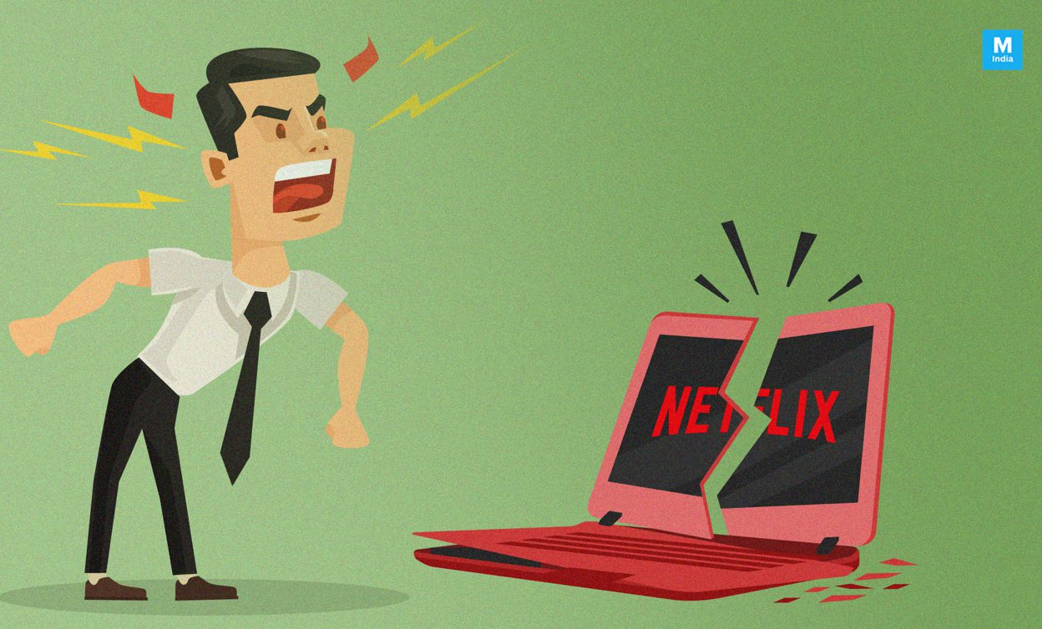
🎬 7. The Netflix (Rollback & Resilience)
Netflix pushes a new update to their app
The update crashes the app for 200 million users.
Engineers scramble for 6 hours. You miss your 9 PM episode. You riot on Twitter.
DevOps Fix: The new feature starts rolling out to 1% of users. It breaks. Automatic rollback — everyone gets the old version back in 30 seconds. You never even noticed. Your episode plays uninterrupted. Engineers fix it quietly and updated app the next day

Slide 11
🗺️ The Analogy Map

Slide 12
DEVOPS IS NOT ABOUT TOOLS — IT'S ABOUT MINDSET.
Talk more (Culture) → Automate everything (CI/CD/IaC) → Test early (Shift-Left) → Watch closely (Monitoring) → Break into pieces (Microservices) → Fail safely (Rollback) → Ship faster, sleep better

